Slide 1
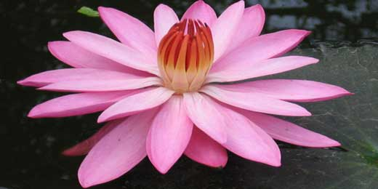

Slide 2
Welcome

Slide 3
MOHAMMAD ALI
Assistant professor of English
Teachers’ Training College, Feni

Slide 4
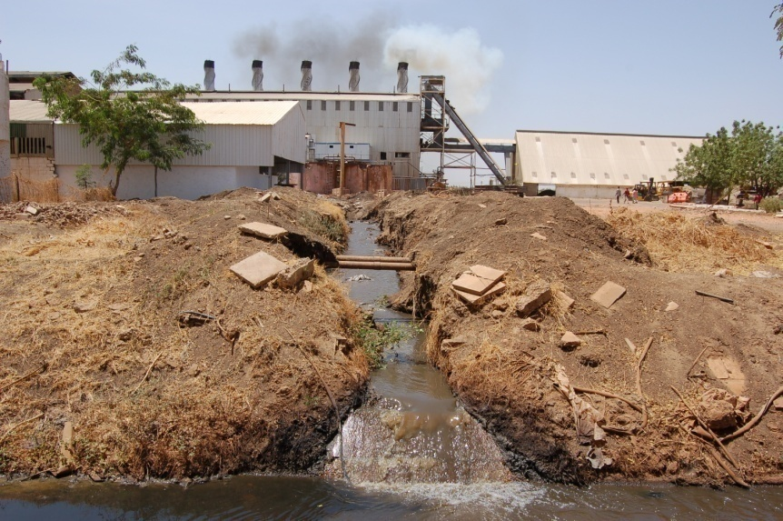
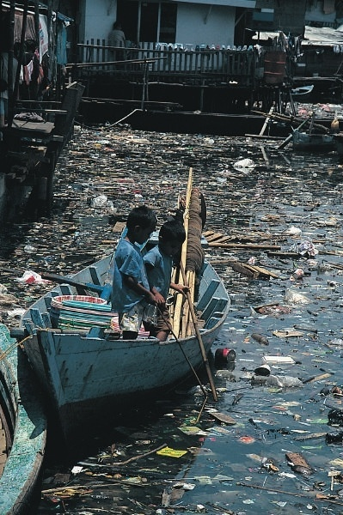
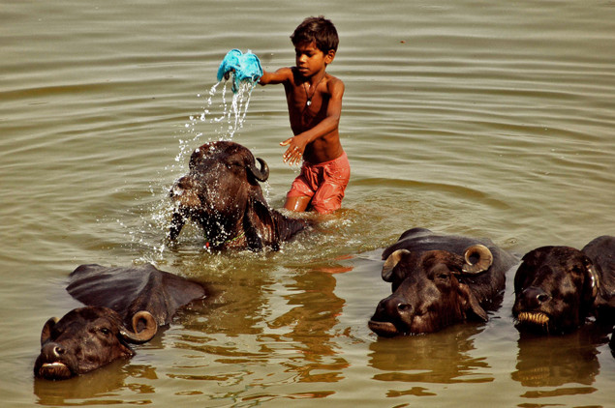
Talk in pair(2/3) minutes
2
1
3
4

Slide 5
The killing water

Slide 6
Lesson’s Objective
By the end of this lesson ss will have-
• mentioned some water borne diseases
• answered questions on arsenicosis/water pollution
abled to find out information from the given text
abled to write down the question information

Slide 7
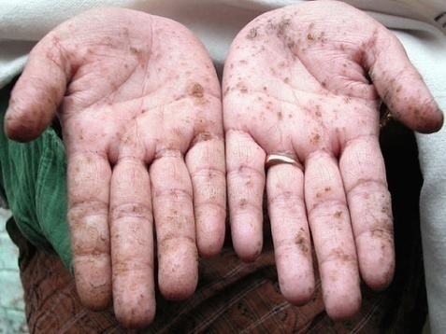

Presentation (Vocabs:)
Arsenicosis-
Disease caused by arsenic
Symtom
Primary sign of any disease

Slide 8
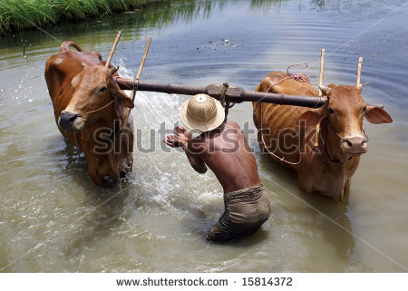

Vocabs
Livestocks-
cattle
Industrial pollution
pollution caused by industrial wastages

Slide 9
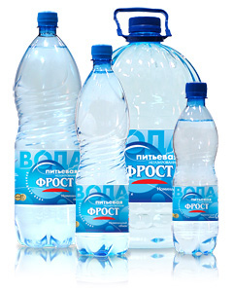
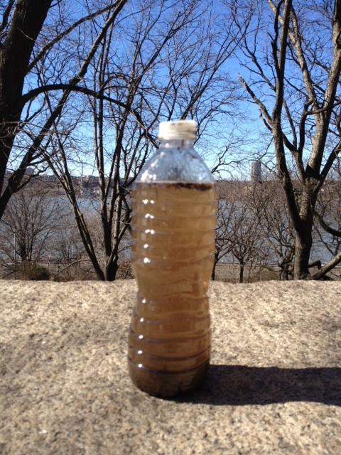
What do you see in the picture

Slide 10
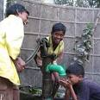

What difference do you see between two tubewell?

Slide 11
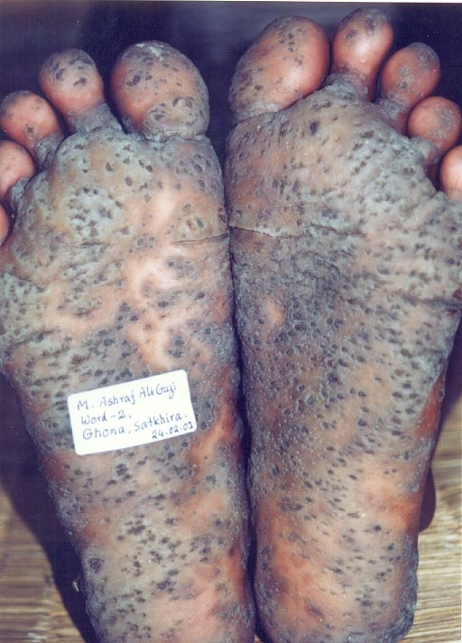

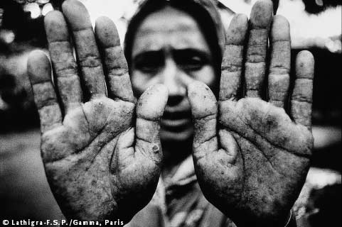
What are these pictures about ?
Why this caused?

Slide 12

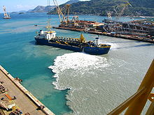
How water is polluted

Slide 13


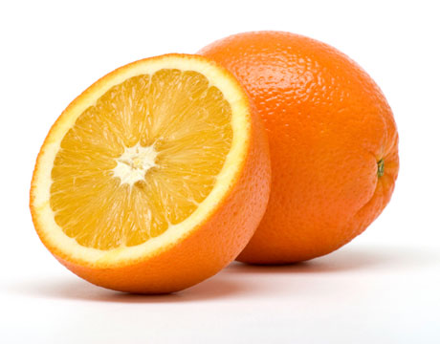
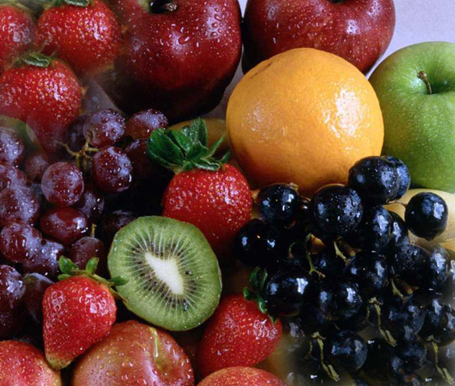

Treatment related to arsenicosis
C
C
Safe water

Slide 14
Group work
How is arsenicosis caused ?
How water is polluted?
How to get rid of arsenic?
You can take help from the text

Slide 15
Evaluation
How is water polluted?
What happens when people drink arsenic contaminated water?
How to get rid of arsenic?

Slide 16
Homework
Suppose your area has been affected by
arsenicosis and you are planning to
publish a leaflet to make people aware of the dangers. Write a leaflet and present in the next class.

Slide 17
Thank you all

